Slide 1
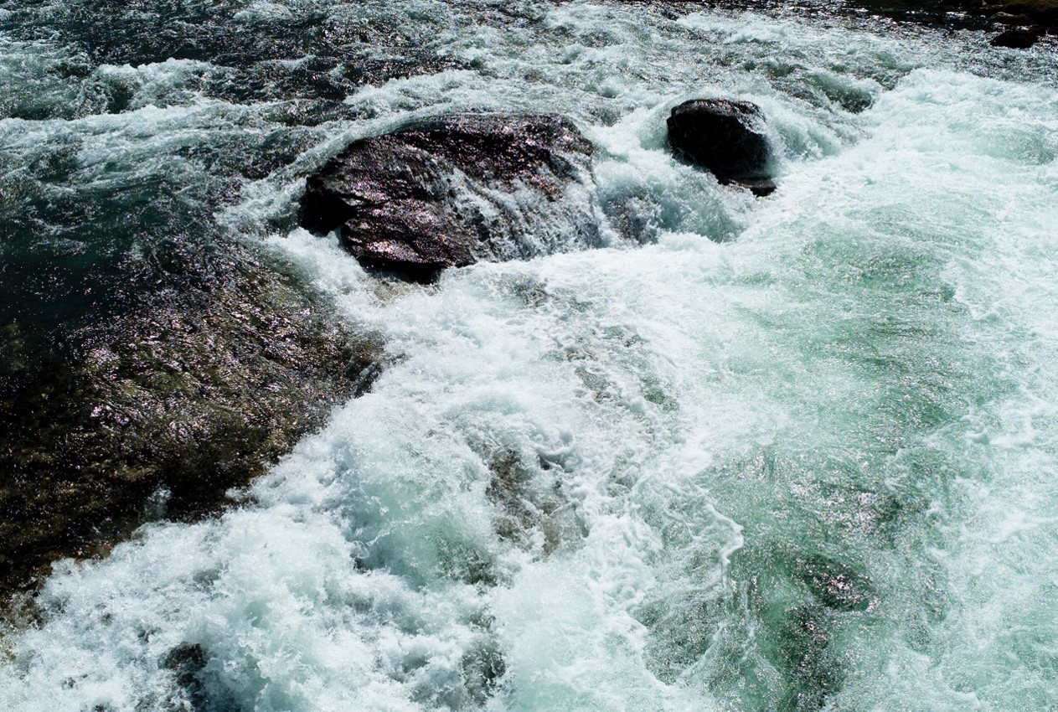
Global Tsunami Model (GTM)
Draft objectives and recap from first scoping meeting
F. Løvholt, C.B. Harbitz
NGI
Second GTM scoping meeting, AECOM, Oakland 13.12.2015

Slide 2


Background
Multi-institutional work on hazard and risk for the UN-ISDR (Global Assessment Report, GAR)
Idea: Need to gather scientific community for
  Collective effort for improved understanding of global tsunami hazard and risk
  Improve methods, develop guidelines and standards, harmonize efforts
  Non-exclusive initiative ↔ open for the community
Initiative from the tsunami community itself
  Proposers: NGI, GA, INGV, USGS, IPMA, GFZ
  No owners or funding at present
Yet GTM should ensure relevance towards external stakeholders
  Societal relevance
  Ambition will – to a considerable extent – depend on success in attracting external funding

Slide 3
The first GTM scoping meeting
Held at IUGG in Prague 29.06.2015
Objective – to discuss and define content to fill GTM
  Short and long term
Points from proponents introduced and accepted
Additional points raised, discussed, and included
Organizational issues were not discussed
  The GTM organization structure is therefore presently open for discussion
  GTM organization main topic for the present meeting

Slide 4

Broad interest in first scoping meeting
Expressed interest or present at meeting
NGI (Løvholt, Harbitz)
INGV (Lorito, Selva, Basili, Tonini)
Geoscience Australia (Cummins, Davies, Griffin)
IPMA (Baptista, Matias, Omira)
IRIDES (Imamura, Suppasri, Mas)
GNS (Power)
METU (Kanoglu, Yalciner)
University of Malaga (Macias)
AECOM (Thio)
MMAF (Muhari)
Univ Bologna (Tinti)
KOERI (Özer, Necmioglu)
MSI (Didenkulova)
PARI (Takagawa)
ICMMG (Giusiakov)
Northwestern University (Okal)
MRI/JMA (Tsushima)
NOAA (Wei, Titov)
Non-present but expressed interest
USGS (Geist)
GFZ (Babeyko)
USC (Lynett)
ITB (Latief)
CIMNE (Bernal, Cardona)
Univ Hamburg (Behrens)
Univ Cantabria (Gonzalez, Gonzalez-Riancho, Aguirre-Ayerbe)
Univ Washington (Gonzalez, Leveque, Adams)
AUTH (Pitilakis)
Total
27 organizations
45 scientists
“External participants” global models
GEM (Pagani, Schneider)
GVM (Jenkins)

Slide 5
Outcomes from the first GTM meeting (1)
Involving the full tsunami hazard and risk community may:
Harmonize efforts and products
Develop standardized and open source tools, guidelines and practices, for among others
  Hazard and risk analysis
  Probabilistic framework and uncertainty analysis
  Underlying methods – source and tsunami models
  Dissemination, mitigation measures, ethical perspectives
Integrate datasets from other providers or compile databases where non-existent
Validation of methods
  Basic methods (e.g. simulation tools)
  Towards hazard and risk data - improve our understanding of the risk drivers

Slide 6
Outcomes from the first GTM meeting (2)
GTM should work on different regional scales
  Become a term of reference for regional efforts
  Ensure compatibility from regional to local scales
  Methodology standard and global reference for hazard and risk maps
Utilize ongoing activities or planned activities
  GTM endorsement – compatible methods or results
Harmonized efforts between institutions
  e.g. – integrate national hazard maps to regional scale
  (TSUMAPS-NEAM – INGV++)
  e.g. multifunctional tools for interfacing models (Tsunami API - GNS)
Facilitate integration of results and tools from related organizations such as GEM and GVM – and assign borderlines

Slide 7
Scientific objectives from the first GTM meeting (1)
Seismic source (probability and modeling)
  Interfacing the GEM, adaptation for tsunami sources and recurrence
Non Seismic source (probability and modeling)
  Interfacing GVM, ICL, submarine landslide community
Tsunami modelling
Development of methods and numerical tools
  Models, unified code interfaces
  Benchmark tests
  Model and data repositories – licensing and / or open source
PTHA (seismic and non-seismic→ landslides and volcanoes)
  Different frameworks
  Uncertainty treatment
  Validation and testing
  Mapping

Slide 8
Scientific objectives from the first GTM meeting (2)
Vulnerability and fragility
  Fragility and mortality
  Uncertainty treatment
Probabilistic Tsunami Risk Assessment
  Framework and uncertainty
  Validation, testing, mapping
Dissemination
  Geo-ethics, transparency
  Risk and uncertainty communication, interfacing stakeholders
  Questionnaires, training, data exchange

Slide 9
Proposed first objective for the GTM
Need for a first project to spark GTM
Initially - Focus on tsunami hazard
Employ and develop PTHA
  Beyond standard practice on subduction zone earthquakes (such as GAR)
  Methods and guidelines
  Focus on non-seismic sources
  Focus on crustal earthquakes
Pilot study – TSUMAPS-NEAM
Also - knowhow from GAR and related projects should be entered into GTM and thus contribute to knowhow

Slide 10
Global Tsunami Model (GTM)
Possible organisational structure
C.B. Harbitz, F. Løvholt
NGI
Second GTM scoping meeting, AECOM, Oakland 13.12.2015

Slide 11
Scope
Present organizational structure of GEM and GVM (as we understand it) as a background
Propose a structure for GTM
Provide a basis for plenary discussion
  Conclude as far as possible on the most suitable structure
  Set up a working group based recommendations from this meeting

Slide 12
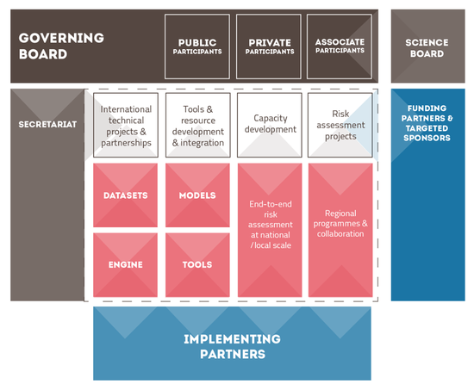
GEM structure
Proposal to OECD - large seed funding - realized in 2009
Organization with a considerable permanent staff
Secretariat in Pavia
Broad international partnership
Similar objectives as proposed for GTM
Funding from national partners?

Slide 13
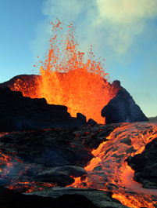
GVM structure
Emerged from UK “VOGRIPA” project
Primary focus – a joint global volcano database
  More recently also hazard and risk (also GAR contribution)
Similar board structure as GEM
  Management board
  Science board
Present secretariat at Univ Bristol
Secretariat proposed to move / change cyclically
Limited funding – efficient utilization from individual projects
In kind contributions and human resources from partners

Slide 14
Way forward towards establishing a GTM
Initiation phase
  Compose a working group for determining the organization
  Directions for working group from this meeting
Elements that need to be discussed and planned for
  Board (management and advisory / scientific board)
  Physical location of secretariat (NGI not a likely candidate)
  Composition of a limited number of topical working groups
  Timeline for working groups
  Commitment from partners - Letter of Intent
  GTM endorsement mechanism for external projects
  Webpage and repository

Slide 15
Proposed organizational structure for discussion (1)
Possible boards:
Recruit management and scientific board in a similar fashion as GEM and GVM
Scientific / advisory board – gives recommendations to management board
Management and scientific / advisory boards
  Tsunami scientists within and outside GTM
  Related scientists from e.g. GEM and GVM
  External stakeholders (UN, WB, industry and possible funding agencies)

Slide 16
Proposed management model for discussion (2)
Smaller group than GEM – likely more similar to GVM in size
  Ambition must also reflect the amount of funding raised
GTM Scientific objectives concern development of tools, standards, and guidelines, which is more similar to GEM
This may imply that
  We favor a flexible organization without permanent staff (like GVM)
  We need a secretariat that could be permanent or circulating (preferred)
  The secretariat could be placed at (governmental) organizations that are less dependent on the external funding (than private ones)?
  We need a scientific organizational structure that looks more like GEM
  The first-phase working groups should reflect this organizational structure
  The first phase working groups should recommend targeted and harmonized GTM activities, and compile overview of existing initiatives that GTM may endorse and include

Slide 17
Webpage, repository and secretariat
Establishment and efficient utilization of web-page and data and model repository a critical issue for success of GTM
  For harmonized efforts
  Need to efficiently utilize and link to decentralized and external resources
  Efficient distribution and utilization of common resources (tools and data)
  Dissemination purposes
Secretariat and centralized web-page and resources do not necessarily need to be physically located in the same place
  Locate web-page at organization that is likely to provide long-term maintenance
  Enable circulation of secretariat

Slide 18
Suggested working groups (WGs)
GTM organization WG
Some other possible groups and volunteer participants listed below
Funding and stakeholder WG (could be merged with the one above)
  Anawat Suppasri (Univ Tohoku)
Possible Scientific WGs
  Source modeling
    Andrey Babeyko (GFZ)
  Modeling workflow and validation, numerical modeling
    Jörn Behrens (UHam) Andrey Babeyko (GFZ)
  Probabilistic hazard analysis
    Mauricio Gonzalez (UC)
  Probabilistic risk assessment
    Ignacio Aguirre Ayerbe (UC) Pino Gonzalez-Riancho
  Dissemination and geo-ethics

Slide 19
Global Tsunami Model (GTM)
External stakeholders and possibilities for attracting funding
F. Løvholt, C.B. Harbitz
NGI
Second GTM scoping meeting, AECOM, Oakland 13.12.2015

Slide 20
Needs to ensure external GTM relevance
Need to integrate GTM objectives with external bodies for relevance and funding purposes
National and international body stakeholders
  UN organizations (UN-ISDR, IOC-UNESCO)
  World Bank
  National and regional governments (such as the EU)
  These organizations are to some extent well aware of our initiative
Industry
  Re-insurance and risk assessment
Mutual synergies with related disciplines
  Volcanoes (e.g. GVM)
  Landslides (e.g. ICL, submarine mass movement community)
  Earthquakes (e.g. GEM)

Slide 21
Potential funding sources
Who should we target for funding activities and secretariat?
  Industry – such as re-insurance and risk?
  Independent foundations?
  National and international science councils?
Some preliminary uncoordinated contacts have been made
  Contact with industry on funding and scientific interaction
  A more targeted and coordinated effort is needed
Possible prerequisites for advertising the GTM
  Written document, such as a white paper
  Plans for GTM products and services
  Dissemination and discussion with external stakeholders and industry
  Working group concerning funding

Slide 22
Balancing funding and utilization of related activities
Funding may be needed for
  Organizing workshops and meetings
  Personnel exchange?
  Students and postdocs working under GTM umbrella
  Hourly based salaries for private organizations
  Secretariat / GTM host – webpage etc.
  Target areas where GTM sees need
Ongoing / in-kind activities needs to be utilized and endorsed by GTM
  Related projects
  Strategically founded activities in e.g. governmental organizations
  Linked and disseminated via proposed GTM web page

Slide 23
Follow up activities on dissemination
White paper – broad author list?
  Describe state-of-the-art on tsunami hazard and risk community
  Outline future tasks for GTM
  Different levels (short document, scientific paper)?
  Needed for dissemination purposes
Dissemination meeting with stakeholders?
  Possible contact – OASIS risk network (based on phone meeting)
  Possible dissemination on insurance risk community meeting in Florida (winter / spring?)
  Feedback on industry needs
Other dissemination
  UN-ISDR science meeting in Geneva, January
  GTM poster presentation
    Expected notification from UN-ISDR Tuesday 15 December
    Poster submission deadline in case of acceptance, 31 December
  Invite re-insurance industry? Other Stakeholders? Dedicated workshop (possibly in London?) was proposed by OASIS

Slide 24
WG Organization
Setup secretariat/identify host
Coordinate white paper (5 months, for Worldbank understanding Risk meeting)
  What/Why/How?
  Identify needs
Commitment structure/letters of interest/MOU
  Study internal financial contributions or in-kind
  Study requirements for Formal/legal structure
Timeframe of 1 yr for getting off the ground
Independent reviewers in management board
WG members - NGI (C.B. Harbitz), IPMA (M.A. Baptista), GA (P. Cummins), UniBo (A. Armigliato), NOAA (V. Titov), INGV (?)

Slide 25
WG Stakeholders and funding
Contribute to goal and objectives of the whitepaper
Collect info on national/regional initiatives
Identify stakeholders/sponsors
  Needs of stakeholders/funding opportunities
  Link to products developed under GTM
  Educational and capacity building aspects
Present at meetings
  ISDR meeting (Jan 2016)
  Cat Risk Management meeting (Feb 16)
  TOWS (Feb 22-26)
  Worldbank (May 16-20) Istanbul
  Workshop with OASIS and third parties
Study issues with proprietary data/software
Contact agencies working in developing countries
WG members: IRIDES (A. Suppasri), A. Yalciner (METU), NGI, (F. Løvholt), GA (?), INGV (?), Issa El Hussain (Oman), possibly more?

Slide 26
WG methods (1)
Summarize the different methodological portifolios and identify gaps
    Source modeling, tsunami modeling, probability framework, hazard, vulnerability, risk …
Identify overlaps with related groups (e.g. GEM, GVM, CSDMS)
Identify topics for pilot projects
Harmonization of outputs and intermediate data
Interoperability – on methodological framework – basic model interfaces
Determining the scope of software development
Testing, validation, and benchmarking
Available open source vs proprietary code for internal exchange
Software engineering support

Slide 27
WG methods (2)
Review other platforms such as GEM, SCEC
  Development of joint tools for instance with GEM
Aspect of multihazard earthquake-tsunami coupling
Review possible hosting platforms such as OASIS and RMS
Technical discussion forums
Technical part of the white paper
Data (topography, bathymetry, census data, ++) – interfacing external databases, feasibility and quality aspects
Work Group members: AECOM (H.K. Thio) Chair
GNS (W. Power), UHam (J. Behrens), UC (M Gonzalez, IA Ayerbe, P Gonzalez-Riancho), GFZ (A. Babeyko), UMA (MJ Castro, JM Gonzalez-Vida, J Macias), METU (U. Kanoglu),, UW (R. Leveque), INGV (Basili, Lorito, Selva), IPMA (R. Omira), UniBo (A. Armigliato), NOAA (Y. Wei), CEA (A. Gailler), USGS (E. Geist)?, IRIDES (A. Suppasri)

